Slide 1
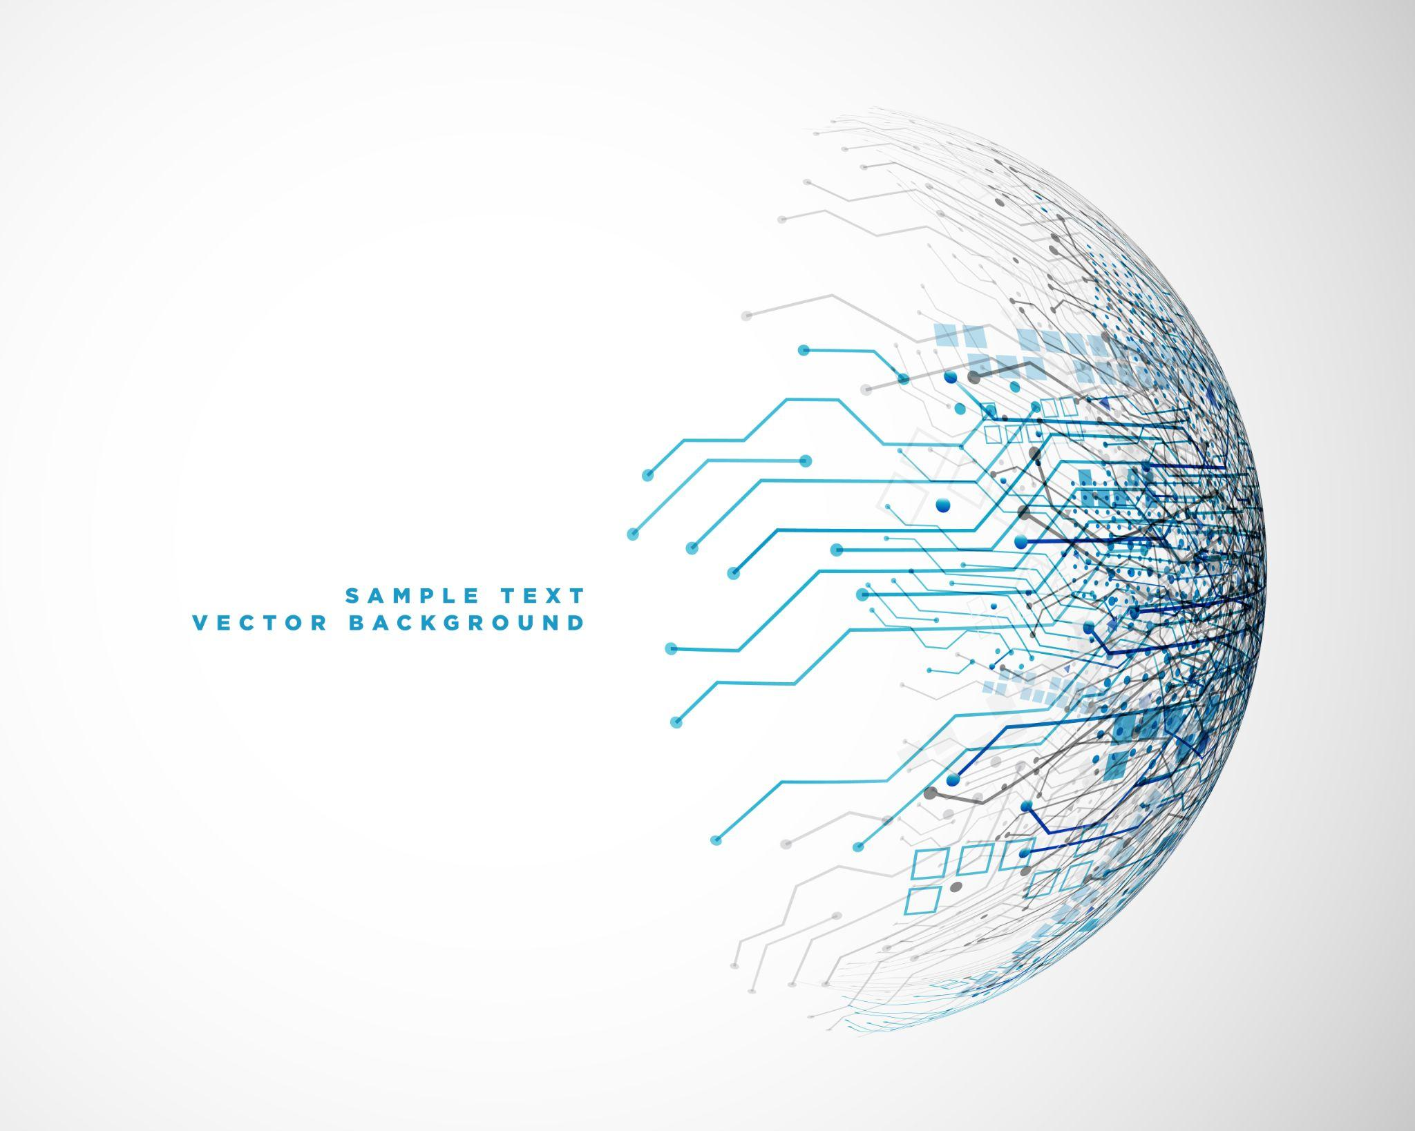

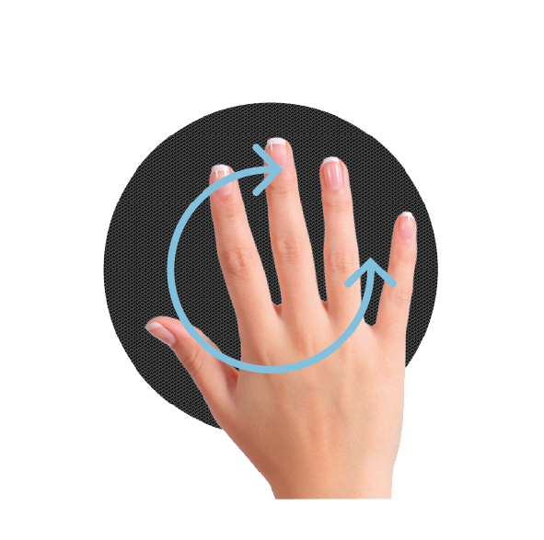

Hand gesture Recognition
LBMP Group#2
Helder Dias
Netra Kulkarni
Pedro Zenário

Slide 2
INDEX
01
02
03
04
INTRODUCTION
RESEARCH
DEEP DIVE
OUR ADAPTATION
05
06
07
08
RESULTS
DISCUSSION
CONCLUSIÓN
REFERENCES

Slide 3

01
INTRODUCTION
Do you know?
Human start speaking with their hands right from the birth!

Slide 4
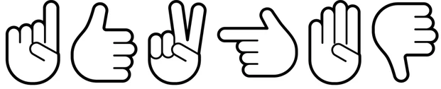
01_PRESENTATION
What is the problem?
This Project Specifications
Recognize Hand Gestures by a trained deep neural network model !
Adapt the article viz “Deep Learning for Hand Gesture Recognition on Skeletal Data” by G. Devineau, F. Moutarde, W. Xi and J. Yang
Identify/Classify a given hand gesture into 15 pre-defined categories.

Slide 5
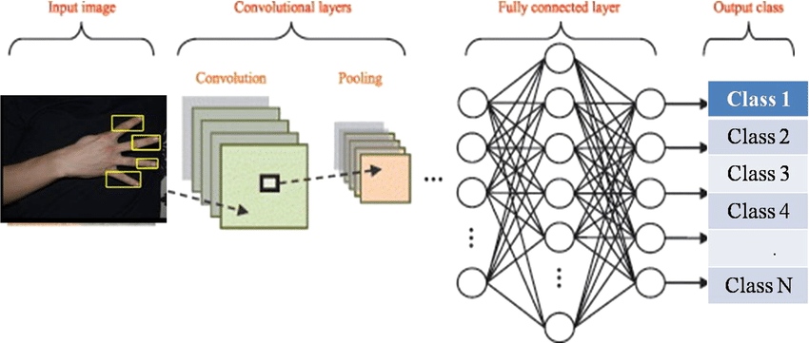
01_PRESENTATION
The Proposed Solution
A Deep Neural Network Model that
uses Sparse representation of the hand as input
extracts temporal features
classifies the input “Gesture” into one of the 15 labels

Slide 6
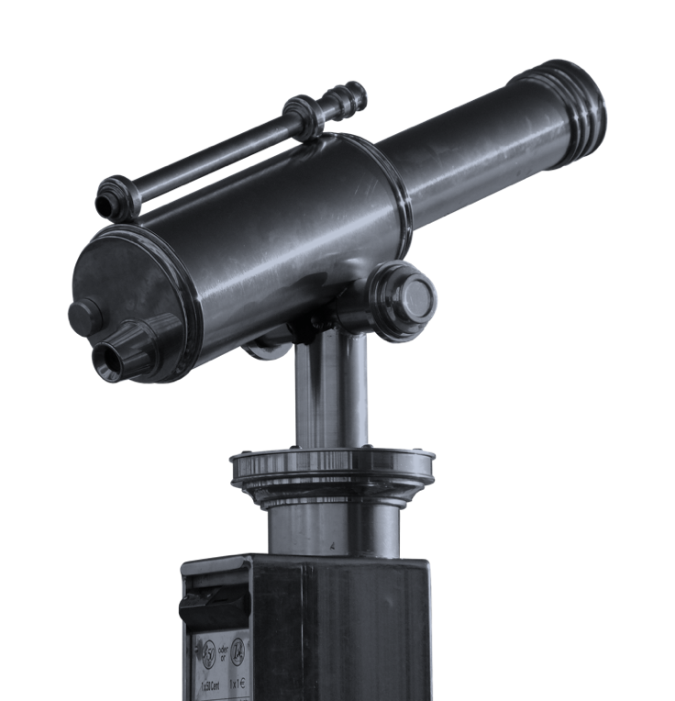
02
RESEARCH
Do you know?
Hand gestures come to us all naturally, even without thinking about it. Even someone who is blind will use hand gestures.

Slide 7
02_INTRODUCTION
What did we already have?
3D Hand Skeleton Dataset for 14 different gestures
Defined Multi-channel residual deep neural network Model
The
analysis
What was our “Adaptation” plan?
Train the model with our own gesture!
Our initial research and findings
What was the major challenge?
Capture a new hand gesture using a normal camera
Transform the video into frames of 3D hand skeleton data points

Slide 8
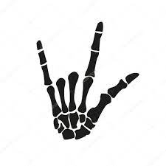



02_INTRODUCTION
The Next Steps
01
02
03
04
Capture our Hand Gesture using our laptop camera
Pre-process it into frames of 22 skeleton points
Re-Train the model using “Transfer Learning”
Predict and Fine tune for better accuracy.

Slide 9

03
Deep Dive
Do you know?
Hand gestures command attention. They can express attitude, emotion, emphasize importance, show shape, direction or approval.

Slide 10

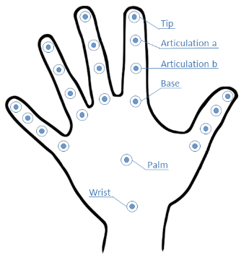
Let's talk about the dataset …
22
14
Each of the 2800 rows contain
100 frames per video
22 * 3 (dims) = 66 data points
Data Points x 3
Dimensions per hand gesture
Gesture classes with 2800 rows of training data

Slide 11
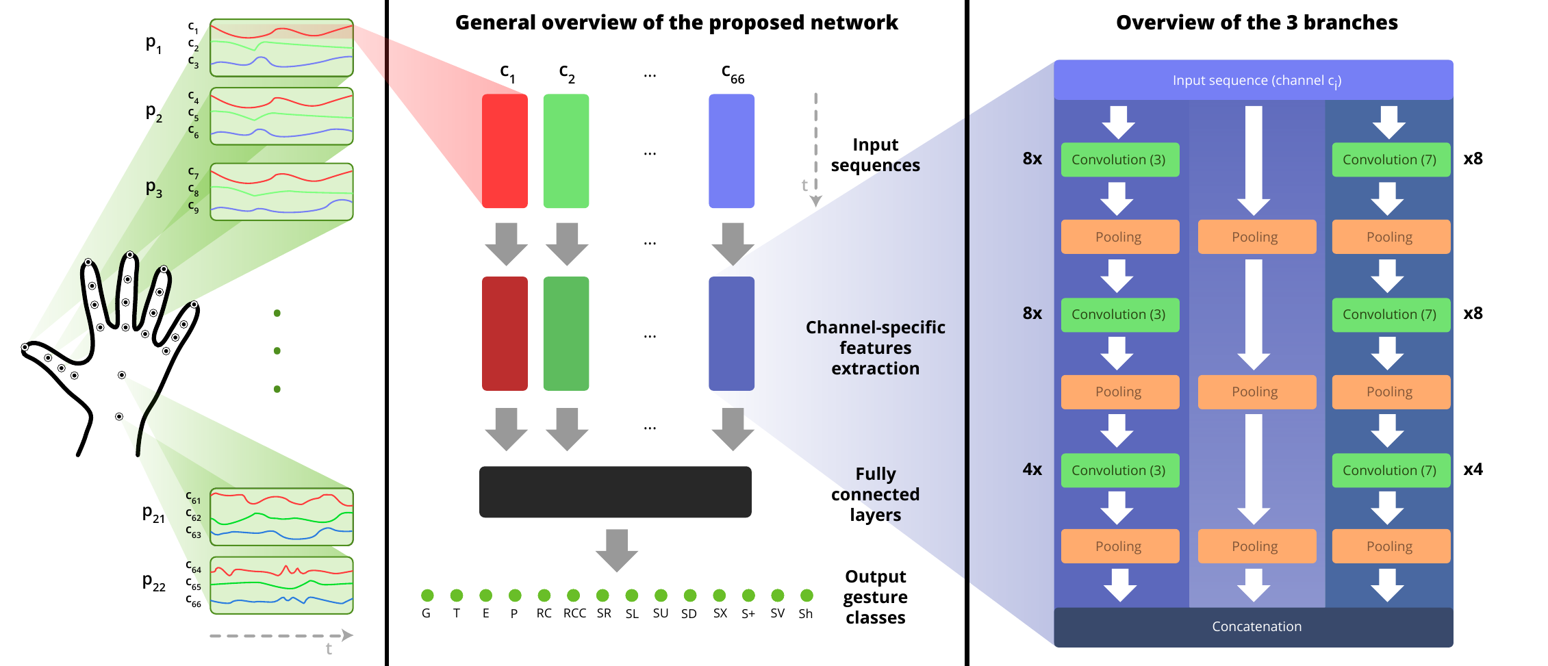
04_ DEEP DIVE
THE MODEL
Multi-channel CNN with 2 feature extraction modules and 1 residual branch per channel.
Source: 2018 13th IEEE International Conference on Automatic Face and Gesture Recognition

Slide 12
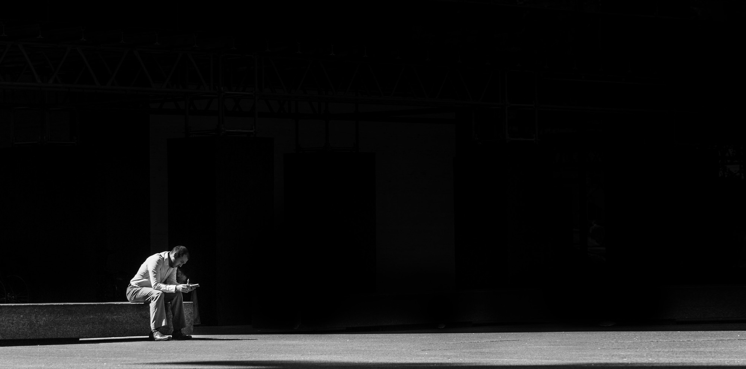
04
Our
ADAPTATION
Do you know?
Hand gestures with your palms showing, signal openness and being truthful — showing you have nothing to hide.

Slide 13

05_ OUR ADAPTATION
5.1 Our Adaptation: The Data
Step 1
So, how did we create our own data to re-train the model?
We captured 100 frames of our new hand Gesture - multiple iterations - through our built-in laptop camera using the “high-fidelity hand and finger tracking solution” by Google called Mediapipe.
This helped us infer 21 3D landmarks of the hand or gesture per frame.
But Our dataset demanded 22 ….

Slide 14
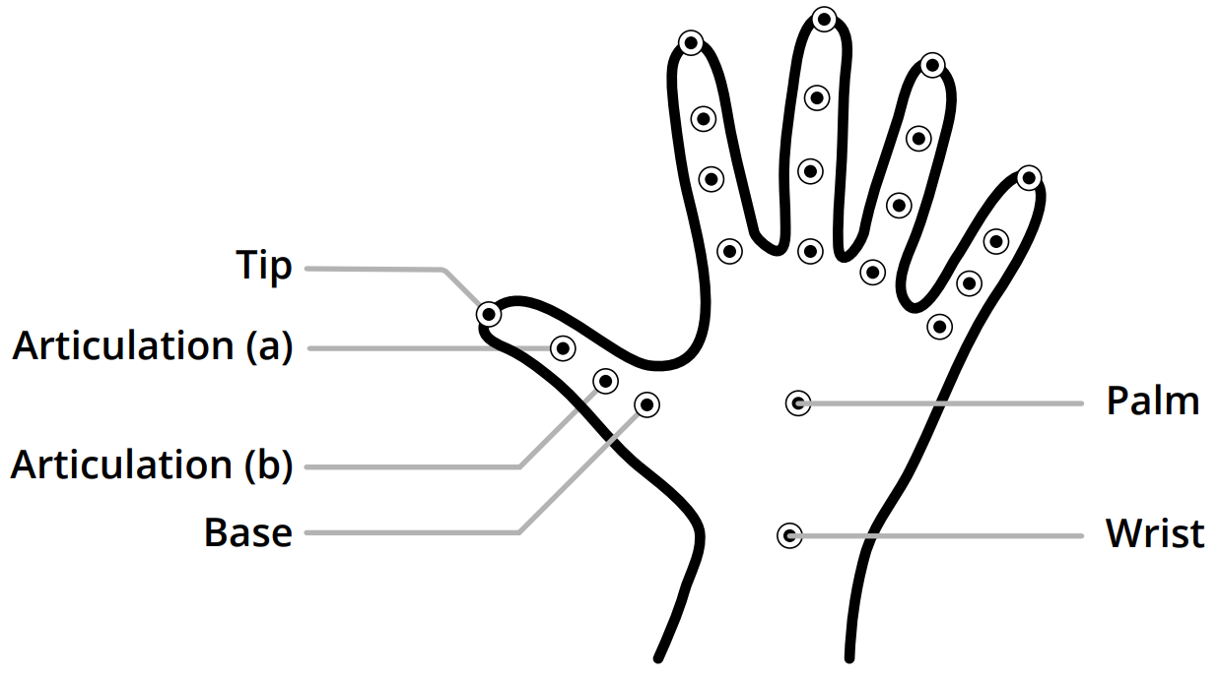

DHG Dataset
MediaPipe Hands
1.Wrist,
2.Palm,
3.thumb_base,
4.thumb_first_joint,
5.thumb_second_joint,
6.thumb_tip,
7.index_base,
8.index_first_joint,
9.index_second_joint,
10.index_tip,
11.middle_base.
12.middle_first_joint,
13.middle_second_joint,
14.middle_tip,
15.ring_base,
16.ring_first_joint,
17.ring_second_joint,
18.ring_tip,
19.pinky_base,
20.pinky_first_joint,
21.pinky_second_joint,
22.pinky_tip.

Slide 15
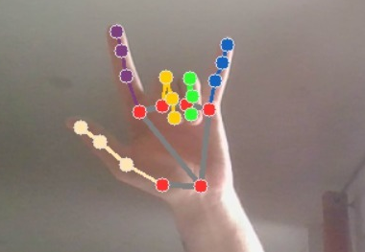
05_ OUR ADAPTATION
Step 2
We pre-processed our captured frames for
Missing Data Point “Palm” : Employed Simple calculation to find the centroid of the triangle made by the wrist, index finger base and little finger base.
Data Preparation: Pickled multiple rows of
recently captured as well as older dataset
almost equally distributed over 15 classes
shaped 100*66
into train and test subsets.

Slide 16
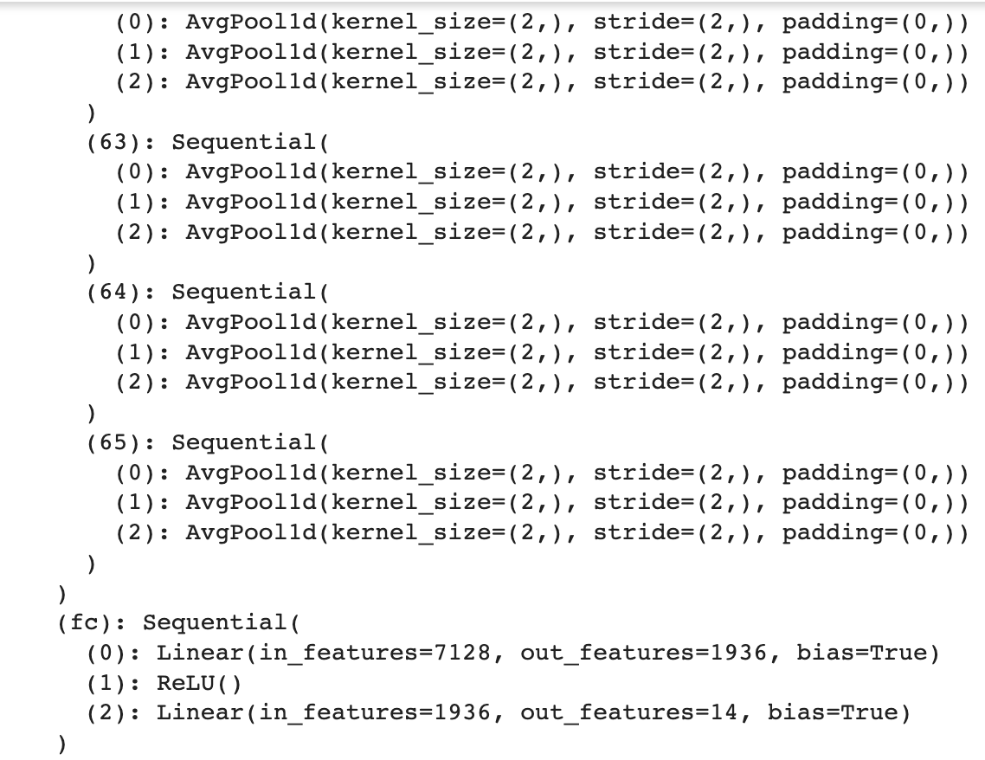
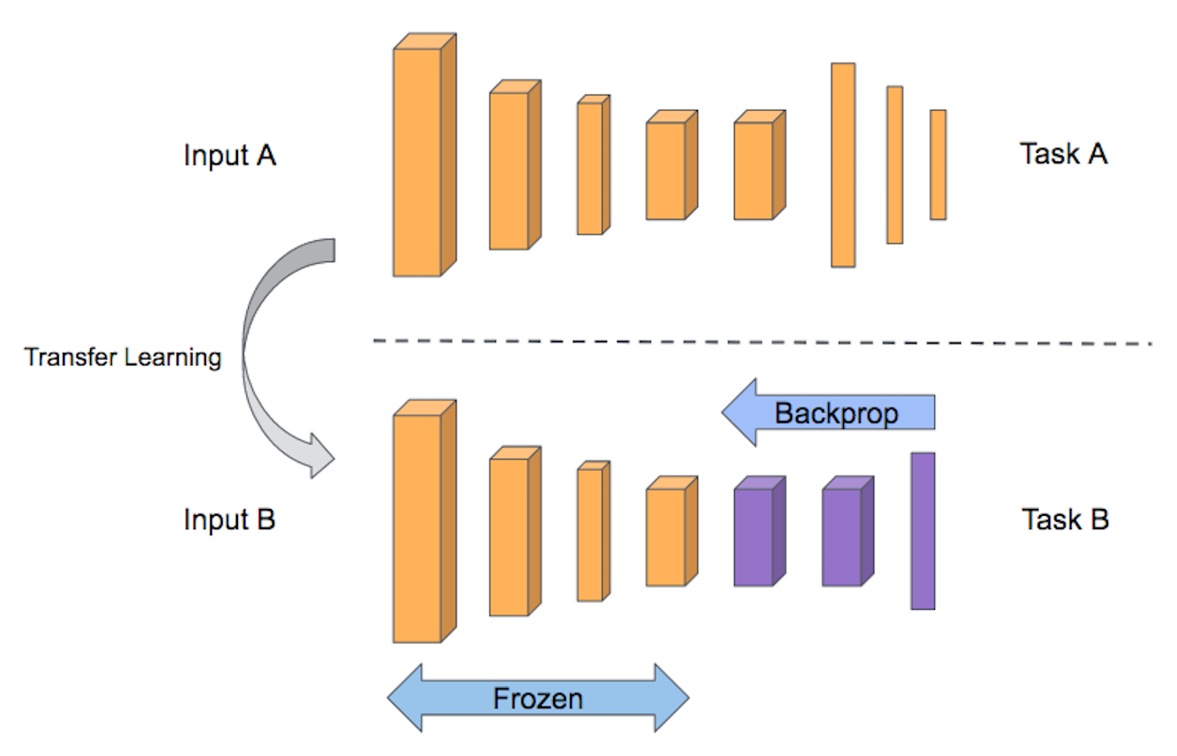

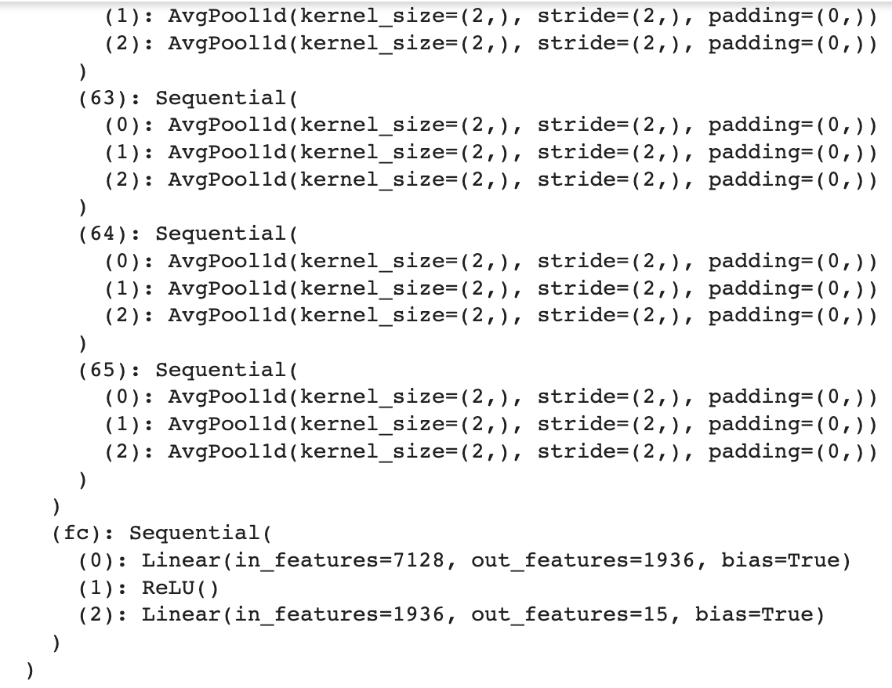

05_ OUR ADAPTATION
5.2 Our Adaptation: Transfer Learning
FROZEN
H
Beneficial with smaller datasets
Faster and resource saving

Slide 17
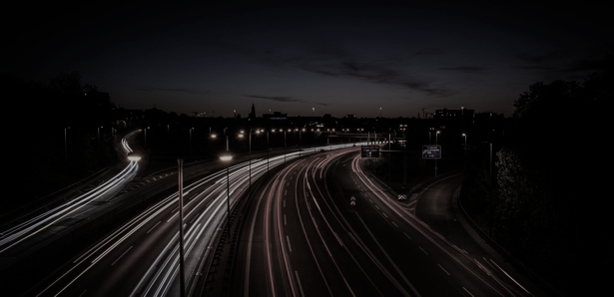
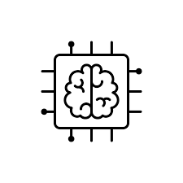
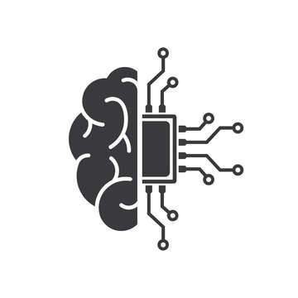


05_ OUR ADAPTATION
~3 iterations
5.3 Our Adaptation: Re-Training
Multiple data combinations, hyper parameter tuning and optimizations
Step 1
Load, pre-process and split New Data
Step 2
Load the model, Prep it for Transfer learning
Step 3
Re-train the model on new data, validate, tune, optimize and repeat
Step 1
Step 2
Step 3
Step 4
Step 4
Final Results

Slide 18
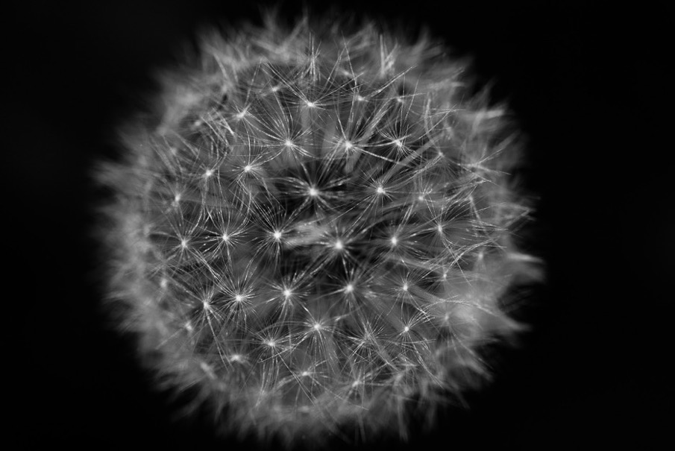
05
RESULTS
Do you know?
Our memory can be impacted by hand gestures. We are able to learn and remember information from the gestures we see and produce.

Slide 19
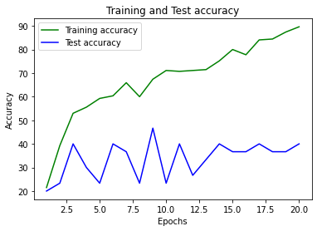
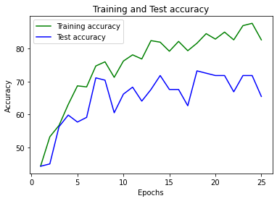
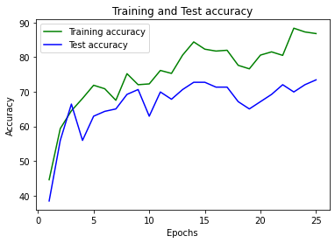
05_ RESULTS
5.1. Qualitative results
Our insights on the iterations
Balanced
Small dataset
Imbalanced
Medium dataset
Balanced
Medium dataset
Over - fit Model
Moderate - fit Model
Good - Fit Model

Slide 20
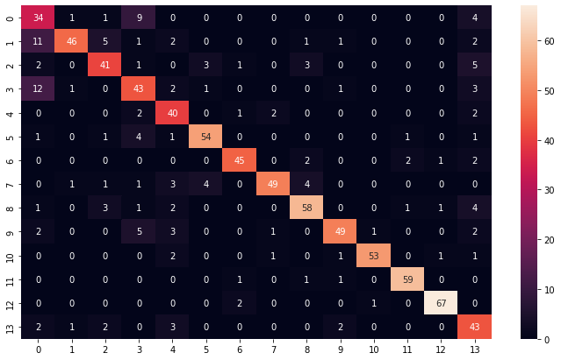
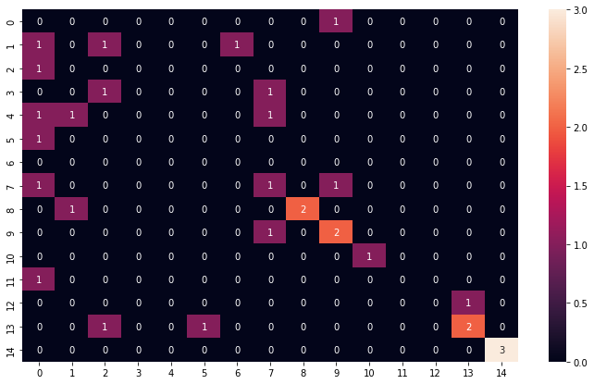
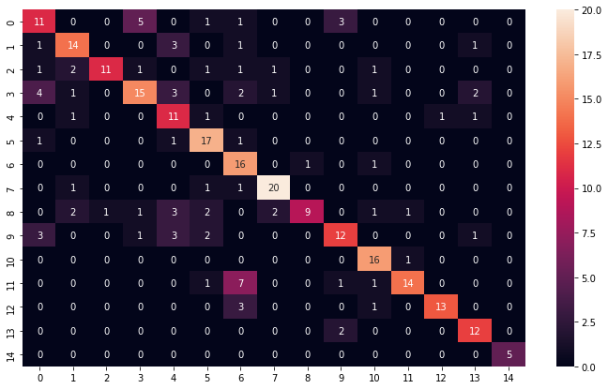
05_ RESULTS
5.2. Qualitative results
Balanced
Original dataset
Balanced
Small dataset
Balanced
Medium dataset
Good - fit Model
Bad - fit Model
Good - Fit Model

Slide 21
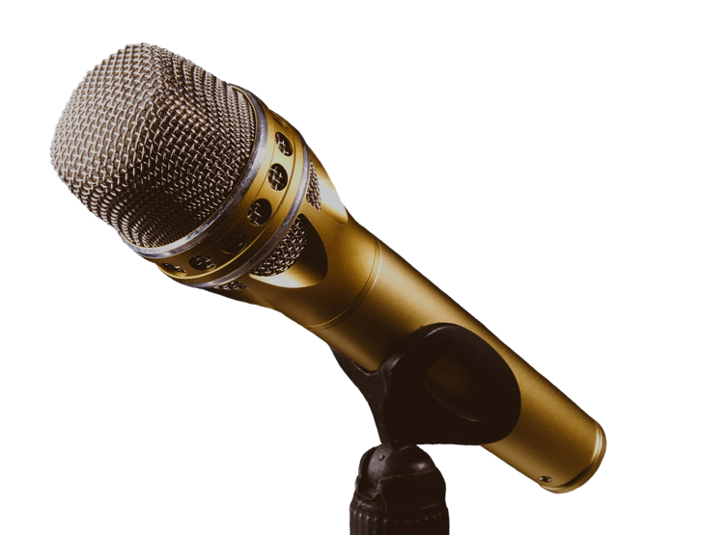
06
DISCUSSION
Do you know?
Bilinguals are more likely to use hand gestures than those who only speak one language.

Slide 22
Transfer Learning or Train from Scratch?
Data Augmentation using SMOTE Technique?
Our BrainStorms
Do we need architectural changes on the model?
Feature Selection or Pre-Processing for the Missing Palm Point?
Will the Model Overfit if re-trained on the same 14 gestures again?

Slide 23
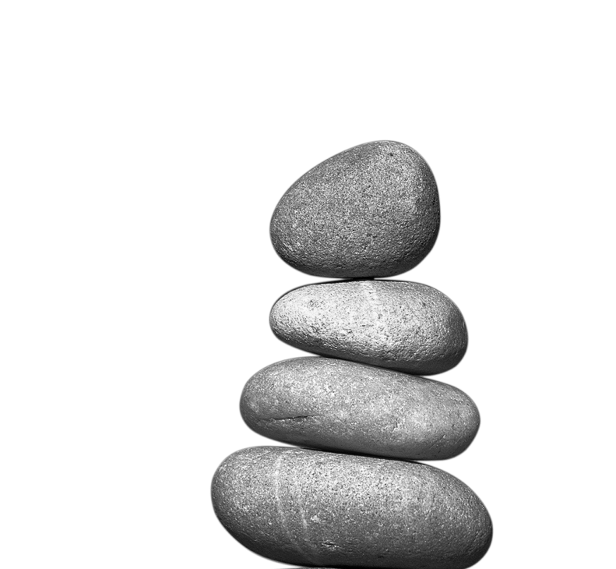
07
CONCLUSION
Do you know?
Over-gesturing — think hands raised above the shoulders — can appear erratic and make you seem less believable.

Slide 24
07_ CONCLUSION
01
02
03
04
Handpicked Pre-trained Model
Captured new Gesture Sample
Pre-Processed into 3D skeleton data
Used Transfer Learning
Re-trained the model on 15 classes (14 older + 1 new)
MCNN pre-trained on 3D skeleton hand gestures for 14 classes
Captured 1 New gesture using our laptop cameras and mediapipe
Processed the data, added the missing point and pickled into the required format

Slide 25


05_ RESULTS
Important conclusion
Multiple iterations of hyper parameter tuning and several dataset compositions helped us achieve an acceptable accuracy on our Model.
75%

Slide 26

08
[1] M. Oudah, A. Al-Naji, and J. Chahl, “Hand gesture recognition based on computer vision: a review of techniques,” journal of Imaging, vol. 6, no. 8, p. 73, 2020.
[2] G. Devineau, F. Moutarde, W. Xi, and J. Yang, “Deep learning for hand gesture recognition on skeletal data,” in 2018 13th IEEE International Conference on Automatic Face & Gesture Recognition (FG 2018). IEEE, 2018, pp. 106–113.
[3] G. Li, H. Tang, Y. Sun, J. Kong, G. Jiang, D. Jiang, B. Tao, S. Xu, and H. Liu, “Hand gesture recognition based on convolution neural network,” Cluster Computing, vol. 22, no. 2, pp. 2719–2729, 2019.
REFERENCE LIST

Slide 27

Open to Questions
Helder Dias
Netra Kulkarni
Pedro Zenário

